Slide 1
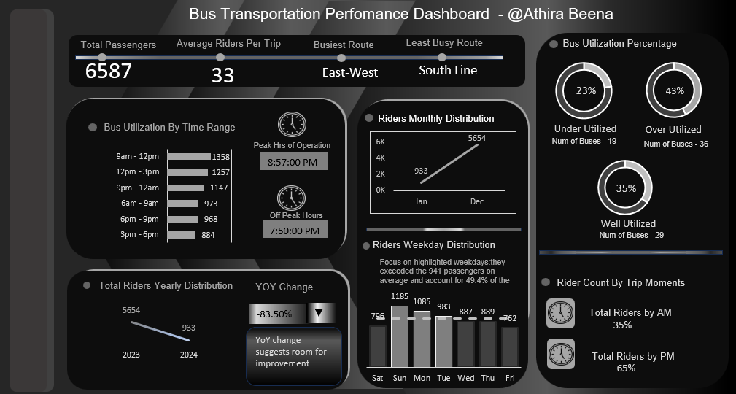

Slide 2
Key Insights from Transportation Analysis Dashboard
Overall Performance
Bus Utilization: The bus utilization percentage varies widely, with 23% for the East-West route and 43% for the South Line. This suggests an imbalance in resource allocation.
Peak Hours: The peak hours are between 9 AM to 12 PM and 5 PM to 8 PM, indicating a high demand for bus services during these times.
Operational Efficiency
Underutilized Buses: The number of underutilized buses (19) is significantly lower than overutilized buses (36), indicating a potential issue with bus distribution and scheduling.
Weekday Ridership: Focus on Mondays, Tuesdays, Wednesdays, and Fridays, as they exceed the average passenger count and account for nearly half of the total riders.

Slide 3
Objective of doing Data Analysis in Bus Transportation Data
The primary objective of doing Transportation analysis is to evaluate the operational efficiency and rider behavior and thereby evaluating the performance of the bus transportation system.
Identify areas of strength and weakness within the system.
Uncover trends and patterns in passenger behavior.
Optimize bus routes and schedules for improved efficiency.
Enhance passenger satisfaction through better service delivery.
Support data-driven decision-making for transportation planning and management.

Slide 4
2. Type of Analysis: What types of analysis can be performed with the data?
Ridership Analysis:
Purpose: Track the number of riders per bus, route, and time period.
Insights: Identify peak usage times, high-demand routes, and underutilized services.
Demographic Analysis:
Purpose: Understand the age, gender, and occupation distribution of riders.
Insights: Tailor services and marketing efforts to different demographic groups
Route Performance Analysis:
Purpose: Evaluate the efficiency and performance of different routes.
Insights: Identify routes with frequent delays, optimize takeoff and arrival times, and improve route planning
Capacity Utilization Analysis:
Purpose: Measure how effectively bus capacity is being utilized.
Insights: Optimize bus deployment and reduce costs by reallocating resources based on demand.
5. Revenue Analysis:
Purpose: Track revenue generated from trip fees across different routes and time periods.
Insights: Identify the most profitable routes and times, and develop pricing strategies
6. Time Analysis:
Purpose: Analyze travel times, including takeoff, arrival, and total trip duration.
Insights: Improve schedule accuracy, reduce delays, and enhance passenger satisfaction.

Slide 5
3. Usage & Audience: How will the dashboard be used and who will benefit from it?
4. Does Dashboard show categories (qualitative) or numbers (quantitative)?
Usage: The dashboard will be used to monitor and analyze bus ridership, optimize routes, manage fleet capacity, and improve service quality.
Users: The primary users will be transportation managers, operations teams, and executives. Additionally, city planners and policymakers might use the data for strategic planning.
The dashboard will display both qualitative and quantitative data:
Qualitative: Bus routes, start and end locations, rider demographics (age, gender, occupation).
Quantitative: Number of riders, trip fees, bus capacities, times (takeoff and arrival), and ridership statistics.

Slide 6
5. Events to Track: What key events should be monitored?
6. Key metrics: Which metrics are crucial for evaluation?
Daily and hourly ridership counts
Peak and off-peak travel times
Rider demographics per route
Bus capacity utilization
Route performance metrics
Total number of riders per route and time period
Busiest and Least busiest routes
Bus capacity utilization rates
Peak travel times and high-demand routes

Slide 7
7. Time Period :What time frame should be analyzed?
8. User Inclusions : Which users should be considered?
Analysis should be conducted over various time periods:
Weekly, monthly, and yearly trends
Peak vs. off-peak hours
Year-over-year comparisons to identify long-term trends.
The analysis should include all relevant users:
Commuters (daily riders)
Occasional riders (visitors)
Different demographic groups (age, gender, occupation)
Bus drivers and service staff for operational insights

Slide 8
10. Necessity : Why is this analysis necessary?
9. Visuals in Dashboard : How many visuals are needed for clarity?
The dashboard should include 5 to 7 key visuals to provide comprehensive insights while maintaining clarity:
Ridership trend line charts
Bar charts for demographic distributions
Donut charts for bus utilization percentage
Enhance operational efficiency and optimize bus routes
Improve service quality and passenger satisfaction
Ensure effective fleet management and capacity utilization
Support data-driven decision-making for transportation planning
Increase revenue by identifying high-demand routes and times

Slide 9
11.Success Criteria: What will be considered a success in the Analysis?
Success will be measured by:
Increased ridership and passenger satisfaction
Improved on-time performance of buses
Optimized bus capacity utilization
Effective identification and resolution of service issues
Enhanced ability to make informed strategic decisions
Increased revenue from optimized routes and services

Slide 10
12. How Will Analysis Help Stakeholders in Decision Making ?
Operational Efficiency:
Managers and Operations Teams: By analyzing ridership and capacity utilization, they can optimize bus schedules and routes, reduce operational costs, and ensure buses are used efficiently.
Service Improvement:
Customer Service Teams: Demographic and satisfaction analysis helps tailor services to meet passenger needs, improving overall satisfaction and attracting more riders.
Strategic Planning:
Executives and Policymakers: Route performance and revenue analysis provide insights for long-term planning, enabling data-driven decisions on where to expand or cut services.
Financial Performance:
Finance Teams: Revenue analysis assists in understanding profitability across routes, supporting budget allocations and pricing strategies.
Resource Allocation:
Fleet Managers: Capacity utilization analysis helps in the effective allocation of buses, ensuring high-demand routes are well-served while reducing wastage on less busy routes.
Marketing and Customer Engagement:
Marketing Teams: Demographic analysis can inform targeted marketing campaigns to attract different user groups, enhancing rider engagement and satisfaction.

Slide 11
Optimize High-Demand Routes : Increase the frequency of buses on high-demand routes during peak hours to reduce congestion and improve passenger satisfaction. Improve Low-Utilization Routes : Implement targeted marketing campaigns to raise awareness and attract more riders to underutilized routes. Adjust Bus Schedules Recommendation: Analyze bus utilization by time to identify peak and off-peak hours. Adjust schedules to match demand, ensuring more buses are available when needed and reducing service during low-demand times to save resources. Resource Allocation Recommendation: Use the insights from the busiest and least busy routes to allocate buses and drivers more efficiently, ensuring optimal resource utilization across the network.
Actionable Recommendations for Optimizing Bus Transportation

Slide 12
Thank you for reading
Found it useful?
Feel free to share !

